Slide 1
RURAL HEALTH - INDIA
Dr. A. MARTHANDA PILLAI
PAST NATIONAL PRESIDENT IMA

Slide 2
IMA VIEW POINTS ON RURAL HEALTH

Slide 3
INDIA LIVES IN VILLAGES
-Mahatma Gandhi
Out of India’s Population of 134 Crores 72.2% lives in 638000 villages and 27.8% in 5480 towns.
IMA HAS TO SOLVE RURAL HEALTH PROBLEMS

Slide 4
Rural Health Statistics 2016 claims that the average rural population covered by these health facilities has increased over the years. Here is the population coverage status of the public health facilities:
Health facility Norm Status (2016)
Sub Center 3000-5000 5377
Primary Health Center 20000-30000 32884
Community Health Center 80000-120000 151316

Slide 5
The overall picture of the health manpower.
India has 19 health workers per 10,000 people (doctors – 6, nurses & midwives – 13). WHO norms calls for 25 per 10,000 people.
Among the 57 countries facing HRH crisis India is ranked 52.
Total MBBS seats (2017) : 67218
PG seats: 40,000
Total number of medical colleges in India 479 as on July 2017
Foreign medical graduates 7500 pass out every year out of which 25% get registration in the national medical registry / year by passing the Qualifying exam.
That means 5600 x 7 years = 39200 graduates are jobless.

Slide 6
The overall picture of the health manpower.
The total number of registered MBBS doctors: (2015)
MBBS Doctors ANM Registered nurse/
midwife
9.36 lakhs 7.56 lakhs 16.73 lakhs
Number of Indians with Foreign Medical Degrees (not passed qualifying examination) 39200 in 7 years
The country has 7.37 lakh practitioners of alternative medicine streams like Ayurveda, Siddha, Homeopathy and Unani registered with the AYUSH Ministry and over 3,600 AYUSH hospitals, the Rajya Sabha was informed. Among them, Ayurveda practitioners' number is 3.99 lakh, while Homeopathy practitioners amount to 2.8 lakh

Slide 7
Skewed Distribution of Health manpower
The seven ‘high Human Resources for Health (HRH) production’ states (i.e. Andhra Pradesh, Telangana, Karnataka, Kerala, Maharashtra, Pondicherry and Tamil Nadu) with 31% of the Indian population, have a disproportionately high share of MBBS seats (58%) and nursing colleges (63%).
The eight ‘low HRH production’ states (i.e. Bihar, Chhattisgarh, Jharkhand, Madhya Pradesh, Odisha, Rajasthan, Uttaranchal and Uttar Pradesh), with 46% of India’s population, have only 21% of MBBS seats and 20% nursing colleges.
59.2% were in urban areas, where 27.8% of the population resides Doctor patient ratio around 1:500
40.8% were in rural areas, where 72.2% of the population resides Doctor patient ratio around 1:2000

Slide 8
LACK OF INFRASRUCTURE AT CHC, PHC, SCs
In terms of facilities the SCs, PHCs and CHCs are ill equipped to cater to the community healthcare needs.
For instance only 55.1% SCs have quarters for the ANMs. Amongst these SCs with quarters, in 62.7% of them ANMs are living in the quarters. This data might appear as a simple piece of statistic but its significance is huge. An ANM living in the quarter of the SC increases the likelihood of the patient receiving healthcare from the ANM even during odd hours. Obviously it also increases the likelihood of the SC to be operational during the normal working hours. This also increases the probability of a pregnant woman receiving basic care even at midnight.
Source: Rural Health Statistics - 2016

Slide 9
LACK OF INFRASRUCTURE AT CHC, PHC, SCs
The report says that 71% of the PHCs have labour rooms. But the report does not say how many of these labour rooms are functional as per IPHS norms and whether they have basic equipment such as ambu bag, oxygen cylinder and baby warmer.
8% of the PHC centers do not have doctors or medical staff, 39% do not have lab technicians, 18% PHCs do not even have a pharmacist.

Slide 10
Situation analysis
In 2006, only 26% of doctors resided in rural areas, serving 72% of India’s population
Density of nurses is three times higher in urban areas than rural areas.
The above facts clearly shows that there is less number of medical colleges in states where there are already shortage of doctors (skewed distribution) The syllabi and curriculum of MBBS do not give exposure to a medical student regarding rural heath scenario. The entrance examination system for MBBS itself promotes city-based candidates to get admission

Slide 11
Health Parameters of the Population and the Availability of Health-Manpower
When comparing with 0.4 of Sri Lanka and 0.3 of Thailand, India had a Doctor population ratio of 0.5 per 1000 persons in 2005.
India had 2.19 nurses and midwives per doctor compared to Sri Lanka’s 3.94 and Thailand’s 5.07. In comparison between Sri Lanka and India.
Sri Lanka has better health parameters even though India has more Doctor per population.
Projecting Human Resource (HR) at present we have 0.5 doctors per 1000 population which is expected to reach only 0.75 per 1000 even by 2022 and that too, with around 180 plus new medical colleges getting added in next few years. But the gap of requirement of nurses and midwives are very high

Slide 12
The doctor population ratio is not the only criteria for better health parameters.
It is the combined number of doctor, nurse, midwife and community health workers available per 1000 population which is more important.
Though India has to increase the number of doctors, more important is to increase the number of nurses, midwives and other health staff.

Slide 13
Health Parameters of the Population and the Availability of Health-Manpower
Projected availability of Modern Medicine Doctors and Nurses
 | 2011 | 2017 | 2022
Modern Medicine doctors, nurses and midwives per 1000 population | 1.29 | 1.93 | 2.53
Population served per Modern Medicine doctor | 1953 | 1731 | 1451
Ratio of nurses and midwives per Ratio per Modern Medicine doctor | 1.53 | 2.33 | 2.94
Ratio of nurses to a Modern Medicine Doctor | 1.05 | 1.81 | 2.22

Slide 14
Areas which require equal attention for improving the health of the public:
Improving social determinants of health like protected water, sanitary toilets, nutrition, reduction of environmental pollution and provision for housing all contribute to health of the population.
Increasing awareness regarding healthy living among the public. Promoting hospital based delivery.
Promoting immunization and other preventive measures.

Slide 15
Some facts from the National Sample Survey (2014)

Slide 16
More than 90 percent population is using modern medicine for treatment. Private doctors were the most important single source of treatment – more than 50% both in rural and urban areas
72 per cent ailment in the rural areas and 79 per cent ailment in the urban areas were treated in the private sector (consisting of private doctors, nursing homes, private hospitals, charitable institutions)
Hospitalization care- mostly in private modern medicine institutions

Slide 18
Irrespective of urban/rural, financial capacity, people prefer modern medicine for OP Care

Slide 19
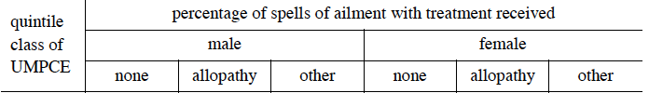
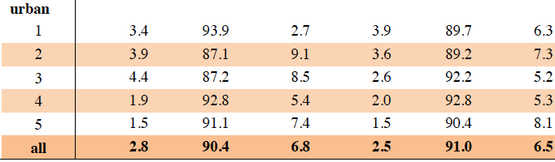

Slide 20
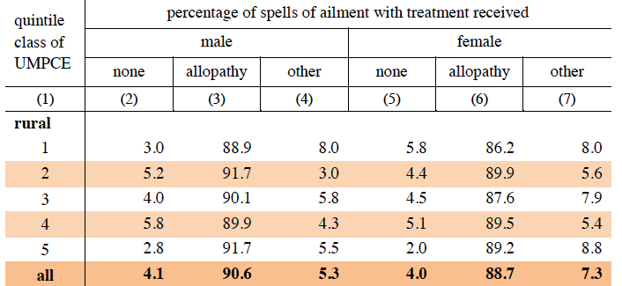

Slide 21

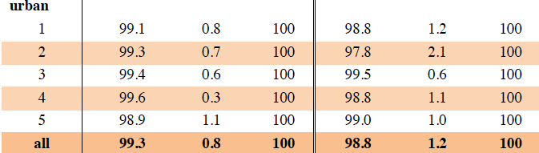
For IP care, the evidence is even clear, no one prefers other than modern medicine

Slide 22
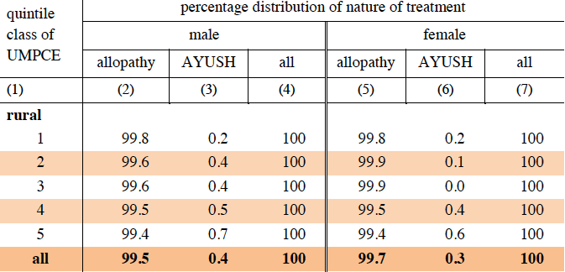

Slide 23
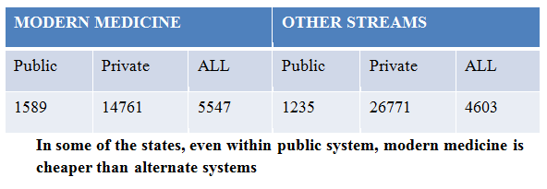
Is alternate streams cheaper?
Average medical expense per childbirth, national average in Rupees

Slide 24
Limited resources and inequity in allocation
AYUSH allocation and utilization of central fund in CRORES

Slide 25
Budgetary allocation for health – the key to improving public health
In 2015 budget, total health allocation decreased by 5.7 %
  But out of 33,152 crore AYUSH gets 1,214 crore (3.7%)
  Whereas 0.5% of population use AYUSH for health care
The approved allocation of the AYUSH department has been increasing progressively over the years.
  The allocation of the 12th Five Year Plan of Rs.10,044 crore amounts to an increase of 235 per cent over the actual expenditure of 11th plan

Slide 26
WHY IMA OBJECT AYUSH WITH BRIDGE COURSE AT PHC’S

Slide 27
AYUSH Bridge course
Posting of AYUSH Doctors after Bridge course in PHC's and SC's is not a solution for improving Rural Health.
The role of Doctor at the PHC is 20% curative and 80% preventive including immunization and improving social determinants of health .
The knowledge to prescribe 15 or 20 modern medical drugs is not enough in handling emergencies like imminent delivery, Myocardial Infarct, Cerebro Vascular Accidents, RTA, Acute organ diseases, etc.
Practitioners of other systems of medicine who do not believe in infections, micro organisms, and those who believe that when the concentration of a drug is reduced efficiency will improve cannot give leadership to immunization.

Slide 28
AYUSH Bridge course
This will be the best way to destroy alternate systems of medicine and deny the population who look forward to alternate pure systems of medicine.
More over there are more than 7.5 lakhs of AYUSH practitioners. when we need hardly 5000 doctors more to fill vacant posts in PHC's what is the criteria to choose 5000 AYSH doctors out of 7.5 lakhs.
Regarding immediate need for modern medical doctors at the ratio of 1/ 1000 population
At present GOI has one PHC serving 30000 population. Even in this facilities are lacking.
The magical number of 1/1000 is not required in the next 10 years till government investment, in facilities and staff pattern improvement
Today the need is hardly 5000 doctors to fill vacancies in PHC’s
For the temporary requirement an incorporation of a clause for separate registration in NMC bill is not required

Slide 29
AYUSH Bridge course
By filling the gap in manpower requirement by compromise health workers ( AYUSH with bridge course) will amount to two standards of health care for the citizens of India.

Slide 30
Failed Experiment.
Under NRHM, services of AYUSH practitioners are utilized for managing common childhood illness, counselling on family planning methods and as Skilled Birth Attendants (SBA).
  Even allowing AYUSH practitioners as SBA will definitely result in mismanagement of new born.
  The infant mortality rate has not decreased in the states where AYUSH practitioners used as SBA.

Slide 31
LEGAL AND CONSTITUTIONAL ISSUES
Taking into consideration of various provisions of the IMC Act and the Supreme Court and consumer court judgments- constitutionally and legally AYUSH practitioners should not be allowed to practice or prescribe modern medicine.

Slide 32
Question of career advancement and demand for Post Graduate education
If AYUSH / Nurse practitioners are posted as Officers in charge of PHCs / Sub centres they will legitimately demand promotional opportunities and post graduate educational opportunities which would be difficult to deny by the government which in turn will create a situation MBBS graduates have to work under AYUSH / Nurse practitioners.

Slide 33
IMA Solution to address rural health issues.
Budgetary provision for health should be increased from 1.1 of GDP to 5. Allotment for rural health should be more.
How to reverse urban rural disproportion?
Start new medical colleges only in rural areas
  Upgrade district hospitals to medical colleges.
  Preference to be given to local candidates for MBBS on condition that they will serve the rural area at least for 2 years
Criteria for medical admission
  give more weightage for performance up to plus two examinations along with entrance marks.

Slide 34
IMA Solution to address rural health issues.
Empowering the family doctor system
The backbone of health care in any country is the family doctor system.
  Family doctors are the first link in health care delivery for the population. They play a pivotal role in preventive health, early diagnosis and timely referral, up keeping of health records of family members.
  Instead of destroying the family doctor system, the service of the family doctors in the respective PHC area particularly where government doctors are not available, can be used on a retainer-ship basis.
  Services of General Practitioners and Family Physicians working near PHC’s where chronically doctors are not available, can be utilized on a contract basis or retainer ship basis.

Slide 35
Why professionals do not prefer Villages….?
Studies have identified various reasons for shortage of doctor in –
Feeling of professional isolation
Disparity in the living conditions e.g. railway colonies
  - Low salary
  - Lack of Safety
  -Poor working condition

Slide 36
Special package should be introduced to attract young doctors.
Offer attractive salaries,
Accommodation,
Nurseries, day care centers for children's of doctors
Facilities for education of children.
Transport facility
Facility for academic activities like internet connection, e medical journals, library,
Allowance for attending CME’s.

Slide 37
Weightage for PG admissions
Rural service by young doctors should be given weightage either by seat reservation or 20% grace marks
Preference to be given for these graduates in permanent appointment
Safety and Security by establishing Health Workers Colonies on the lines of Railway colonies.
Adequate paramedical staff, facilities for investigations and provision for necessary medicines in the PHC’s.

Slide 38
Professionalism in health care delivery including in PHCs
The staff pattern of PHCs to be revised immediately.
In many states the staff pattern of PHCs has not been revised for at least 15 years, and even vacancies in the existing post are notified and measures taken to fill it.
Doctors appointed on contract basis by state / NRHM should be given extension if vacancy persist., they should also be given preference in PSC appointment on those posts.
The working hours for doctors as per International Labour Law is 5 hours.
Shift duty should be introduced in the PHCs so that 24 hrs service can be ensured particularly for delivery and other emergencies.
Modification of curriculum and syllabi of MBBS to suit rural health requirements.
All the doctors should be given training in their job description and on administrative matters before being posted.
Reorientation programmes should be given to doctors posted in PHC’s on Rural Health issues including preventive aspects.

Slide 39
Resource sharing model
Urban India, the private sector accounted for only eight per cent of health services sixty years ago.
The urban health scenario only changed with the growth of the private sector, which now accounts for more than 80 per cent of urban health care.
In villages where Modern Medicine private doctors are working ,health status and statistics have improved e.g. TN and Kerala
India now has a flourishing rural economy and a large number of villagers would want and be able to pay for quality private consultations.

Slide 40
The government has to be more proactive. Rural health care should be a part of a comprehensive socio-cultural, educational, economic and health care developmental package that will be also conducive for participation of private sector and not treated as a standalone commodity
Formation of NATIONAL MEDICAL CADRE where by a Modern Medical Doctors pool is created and they can be posted in PHC’s where local doctors are not available on a special package as mentioned above.

Slide 41
Public Private Partnership- for starting hospitals or medical colleges
Posting of Post Graduate Medical Students in Community Health Centres.
Rural India today needs specialists on a priority basis. Seventy per cent posts of specialists like surgeons, physicians, pediatrician and gynecologists. at the Community Health Centers (CHCs), which provide minimum specialist services to villagers, are lying vacant
In the present system of medical education it takes about 10 years to produce a specialist.
One approach to solve lack of specialists in CHC’s may be to post Postgraduate Medical Students at the CHCs, as part of rotating posting of MD/MS courses.

Slide 42
Each postgraduate student should spend a fixed time (e.g. six months) at a CHC in the second year of his/her training
Utilizing the manpower of Indian foreign qualified doctors (who have not passed qualifying examination) as Assistant Medical Officers in PHCs and Sub Centres
Over the last 7 years there are about 39200 foreign qualified doctors who are jobless. This category of medical personnel can be utilized in sub centres instead of AYUSH or Nurse practitioners. As and when they pass qualifying examination they can be promoted as medical officers in PHCs
Strategic outsourcing of specialist care from the private sector at the territory care level.

Slide 43
Conclusion:
To achieve required doctors, nurses and midwives per 1000 population, our requirement of medical colleges, nursing colleges & schools are huge
The fact that this WHO statistics have been worked out taking into consideration that one doctor sees 25 patients per day as in western countries, where as in India, a doctor sees 200 and above patients per day. So this theoretical number is not immediately necessary.
What we need is more of nurses, midwives and health workers rather than medical doctors alone to achieve better health parameters.

Slide 44
Addressing social determinants of health and increasing budgetary allocation are the need of the hour.
When developed countries and even emerging economies are utilizing post graduates in family medicine as primary health providers, India cannot afford to dilute our standards by leaving health care of the rural population to under qualified personnel.
When India is emerging as an economic power, our health care system cannot go in a retrograde manner by not adhering to international standards in the practice of modern medicine.

Slide 45
IMA strongly oppose inducting AYUSH doctors in any of the modern medical institutions
IMA Appeal to the Government to seriously consider the various solutions proposed

Slide 46
THANK YOU

